Slide 1
Corporate Governance and Risk Management at Unprotected Banks: National Banks in the 1890s
Charles W. Calomiris and Mark Carlson
GCGC, Stanford
June 5, 2015

Slide 2
How Do Banks Raise Funds?
Opacity and management control of risk taking, as well as insider lending, salaries, etc.
Leverage for banks is often high.
How do bankers convince minority shareholder and depositors to invest in the bank?
How do bankers credibly commit to good risk management and to limit transfers to self?
Sufficiently high managerial stakes to align incentives toward risk (but may lead to other rent extraction).
Formal corporate governance can make good management observable to outsiders, reduce managerial rent extraction, and increase capacity to undertake risk (diversification of ownership).

Slide 3
Simple Bank
Loans and cash are two categories of assets
Deposits and equity are two funding sources
Riskiness of assets is given by riskiness (s_{L}) of loans multiplied by loan-to-asset ratio
(L/A) = 1 - (R/A)
Equity ratio is (E/A)
Riskiness of assets = s_{A} = (L/A) s_{L}
Given s, (R/A) and (E/A) are two alternative tools for reducing deposit default risk from loan loss

Slide 4
A Frictionless World
In a frictionless world (perfect information, no transaction cost) a banks choose default risk that depositors want.
In that world, capital and cash are two equally good ways to skin the cat of targeting a given default risk on bank debt.
Depositors enforce that equilibrium by moving away from risky banks and toward lower risk ones.

Slide 5
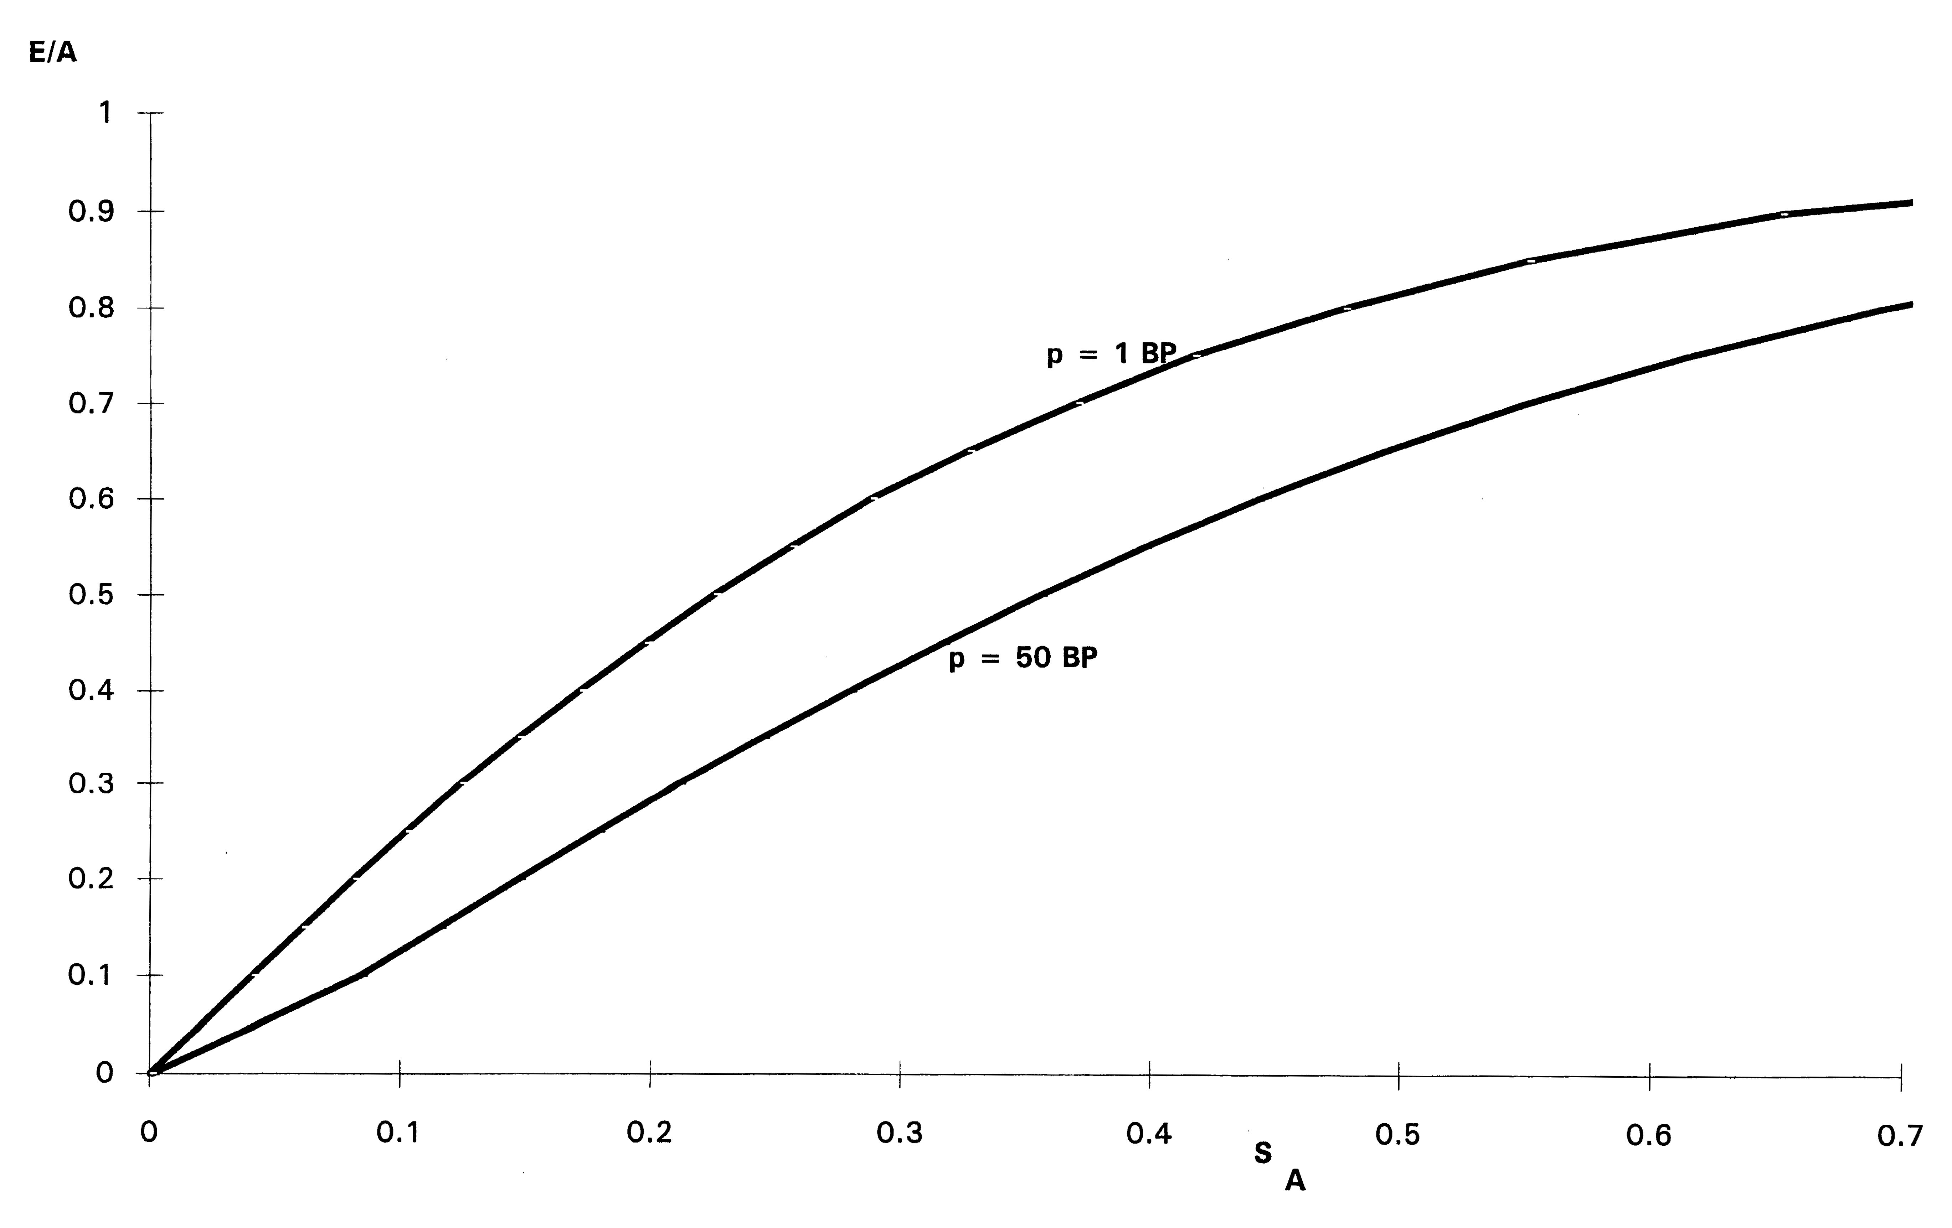
Two Ways to Skin Cat of Default Risk

Slide 6
Frictions and Different Solutions
Unobservable bank opportunities, unobservable ex ante risk management or ex post unobservable outcomes and absconding. (Calomiris Kahn 1991)
Cash has observability and incentive advantages over managerial capital => combination of capital and cash is superior to just capital, and this should depend on cross-sectional differences in the extent of adverse-selection and moral-hazard problems, as well as state of world (recession). (Calomiris Heider Hoerova 2013)
Corporate governance is another dimension: formal governance may increase risk capacity, reduce cash, reduce managerial proportion of ownership.

Slide 7
Governance of National Banks
Examined once-twice a year (semi-random arrival, spatial sequencing).
Five times a year submit “call reports” detailing their balance sheets.
No prudential capital requirements, prudential cash reserve requirements not strictly enforced (as a fraction of deposits; frequent ~15% violations revealed in exams, unclear penalties).
Stock holders face double liability.
Lots of voluntary corporate governance rules.

Slide 8
Ownership Structure, Rents, Risk, and Cash
Ownership structure is a key covariate of corporate governance structure, salaries, inside lending, risk, and relative reliance on cash.
Helpful to think of two kinds of banks:
Closely held banks => informal governance, high mgr salaries and loans, hard to observe risk, but lower default risk; main costs are adverse selection and asset substitution risk in bad states, which are solved with greater reliance on cash as risk control.
Widely held banks => formal governance structure, low salaries and mgr loans, greater tolerance for default risk, less risk of asset substitution in bad states, less reliance on cash.

Slide 9
Sample
All National banks in 37 cities
207 total banks
22 failed in the panic and 36 suspended
Cities are either Western or Southern reserve cities
Kansas City, MO; Louisville, KY; Minneapolis, MN; New Orleans, LA; Omaha, NE
Larger non-reserve cities
Denver, CO; El Paso, TX; Los Angeles, CA; Portland, OR; Spokane, WA; Stillwater, MN
Mid-size banks
Assets of $164 thousand to $8.3 million
Largest banks at the time had ~$35 million in assets

Slide 11
Voluntary Governance Decisions
Independent directors (the number > one)
Board size (4-23, mean of 9)
Frequency of board meetings
Bonding of cashier (60%), bonding of president (35%)
Formal loan approval committee (if included independent director)
Equity-to-assets ratio
Cash-to-assets ratio

Slide 12
Correlation Matrix | Board meets at least monthly | High % Outsiders on Board | Active discount comm. | Pres. bonded | Cashier bonded
Management stock share | -0.23 | -0.44 | -0.25 | -0.15 | -0.22
Board meets at least monthly |  | 0.20 | 0.33 | 0.08 | 0.15
High % Outsiders on Board |  |  | 0.25 | 0.22 | 0.20
Active discount committee |  |  |  | 0.24 | 0.43
Pres. bonded |  |  |  |  | 0.50
Note that all correlations in first row are negative. All other correlations positive.

Slide 13
 | Low Management Ownership Share | Medium Management Ownership | High Management Ownership
Assets ($ millions) | 2.2 | 1.6 | 1.6
Governance Score | 3.2 | 2.9 | 1.7
Pres. Salary /Assets | 0.22 | 0.32 | 0.31
President Bonded | 0.38 | 0.36 | 0.22
Officers’ Loan Share | 2.4 | 3.0 | 4.7
Outs. Dir. Loan Share | 6.2 | 5.5 | 4.1
Dividends per share | 3.5 | 4.8 | 7.6

Slide 14
Measures of Banks’ Risk Choices
Probability of failure or suspension
Reliance on “hot debt” market
Percent Troubled loans (examiners’ opinions)
Estimated loan losses (objective criteria for “bad” loans, plus examiners’ opinions about other “troubled”)
Ex ante measures of loan risk (loan types)

Slide 15
Bank Closures

Slide 16
Instrumenting Ownership and Governnance
Managerial turnover is exogenous (death)
It reduces managerial ownership share, and increases formal governance.
Results for OLS are robust to uses instrumented management share or corporate governance score.

Slide 17
First Stage Regressions
 | Management ownership | Score
Turnover | -0.06*** | 0.38***
 | (0.02) | (0.12)
Log age | 0.05*** | -0.49***
 | (0.02) | (0.14)
Reserve city | -0.01 | .20
 | (0.05) | (0.34)
Log city population | -0.06* | 0.18
 | (0.03) | (0.19)
Log distance to NYC | 0.09* | -1.15***
 | (0.05) | (0.33)
Fraction county income from agriculture | -0.11 | 0.21
 | (0.08) | (0.52)
Mining in state | .05 | .17
 | (.05) | (.32)
Old state | -.04 | .71***
 | .04 | (.25)
Intercept | .19 | 9.20
 | (0.57) | (3.68)
Observations | 206 | 206
Adj R² | 0.18 | .28
F-statistic | 6.53 | 10.9

Slide 18
Insider Rent Seeking
Variables of interest:
Officer salaries
Lending to insiders/officers
Dividends
Results:
Officer salaries are higher when officers own more
Effect of ownership concentration on overall insider lending not strong, but who gets those loans is affected
Officers and outside directors agree on dividends

Slide 19
Relationship to Risk Taking
High management ownership, and less-formal governance, is associated with:
Lower probability of failure, lower reliance on borrowed funds, lower loan losses/assets
Fewer real estate loans
=> Formal governance is associated with more risk

Slide 20
Capital/Cash Mix in Risk Management
More cash/less capital makes sense if asset substitution risk in bad states is higher (or if adverse-selection costs of raising equity are higher).
More formal governance should make risk and risk management more observable and thus reduce relative reliance on cash.
Choosing to be an inside-dominated bank means more information and control problems => greater use of cash, less of capital.

Slide 21
Summary of Second Stage Regressions
 | Management ownership | Score | IV Management ownership | IV Score
Off loans/ins loans | 33.63*** | -4.97*** | 64.29* | -10.4*
Divid/shares | 6.39*** | -0.52* | -8.11 | 1.22
Used borr funds | -1.71*** | 0.08 | -4.45** | 0.65*
RE loans/loans | -3.5* | 0.1 | -10.37 | 1.67
OREO/assets | -1.1** | 0.1 | -1.97 | 0.31
Troub loans/loans | -5.0* | 0.4 | -4.36 | 0.70
Estim loss/assets | -2.2* | -0.4** | 1.00 | -0.17
Bank closed its doors | -0.88* | 0.06 | -3.56* | 0.57
Net worth to assets | -15.55*** | 1.01* | -29.42** | 4.91*
Cash to assets | 2.30** | -0.24 | 8.22* | -1.37*

Slide 22
Extensions and Robustness
Governance score items considered separately
Executive compensation (higher salary/stock compensation leads to more risk)
When outside director has more shares => magnifies risk taking (Laeven Levine 2009)
If neither high mgr ownership or formal gov, greater risk and more perquisites.

Slide 23
Conditional Means
 | High own, high gov | High own, low gov | Low own, high gov | Low own, low gov | Test for diffs in means
 |  |  |  |  | 1 vs 4 | 2 vs 4 | 3 vs 4
Salary/assets | 0.67 | 0.75 | 0.51 | 0.54 |  | *
Off loans/ins loans | 36.3 | 53.3 | 24.7 | 33.9 |  | *** | *
Divid per share | 4.4 | 7.0 | 3.3 | 4.1 |  |  | *
Used borr funds | 20.9 | 27.1 | 33.8 | 45.8 | ** | *
RE loans/loans | 3.2 | 3.5 | 2.5 | 7.3 | ** | ** | ***
OREO/assets | 0.8 | 0.7 | 0.8 | 1.2
Troub loans/loans | 8.8 | 10.4 | 7.3 | 11.5 |  |  | **
Estim Loss/assets | 0.7 | 1.1 | 0.8 | 3.6 | ** | ** | ***
Loan loss/assets | 0.58 | 0.90 | 0.58 | 2.73 | ** | * | ***
Other loss/assets | 0.10 | 0.21 | 0.21 | 0.86 | ** | ** | **
Closed | 30.2 | 28.3 | 25.0 | 33.3

Slide 24
Summary
Concentrated managerial ownership reduces use of formal governance mechanisms.
More formal governance reduces managerial rent extracting (salaries, loans to self).
Formal governance increases tolerance for default risk, in form of higher default risk and willingness/ability to undertake riskier funding choices (borrowed funds).
Concentrated managerial ownership and resulting less formal governance raise adverse-selection costs and asset-substitution risk, which leads to greater reliance on cash than equity for controlling default risk.
Satisfying concerns of outsiders drives ownership structure, governance, and methods of risk management.

